Slide 1

Multithreaded Programming for Mere Mortals
Emery Berger, Charlie Curtsinger, Tongping Liu University of Massachusetts, Amherst

Slide 3
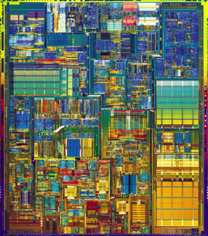
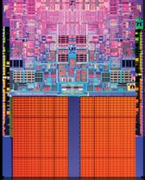

Slide 6


Slide 7
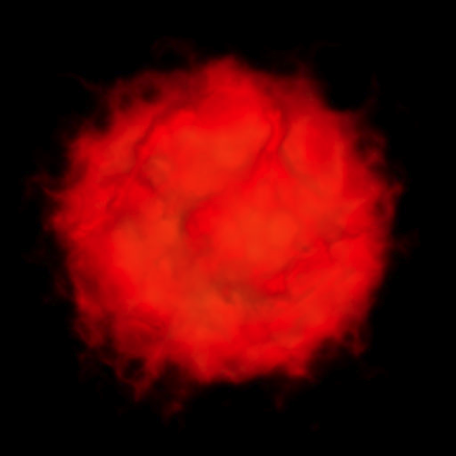

Slide 9
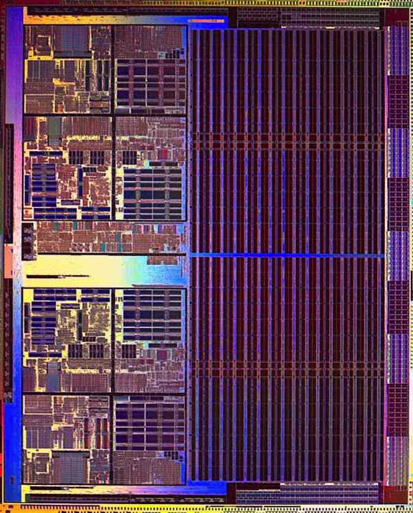

Slide 10
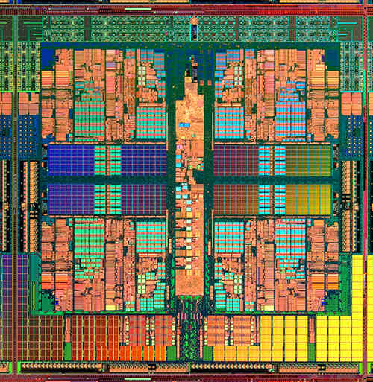

Slide 14
color = ; row = 0; // globals
void nextStripe(){
for (c = 0; c < Width; c++) {
drawBox (c,row,color);
}
color = (color == )?  : ; row++;
}
for (n = 0; n < 9; n++) {
spawn nextStripe();
}
sync;

Slide 15
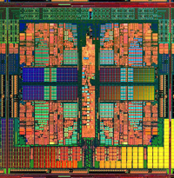
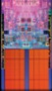
“
”

Slide 16
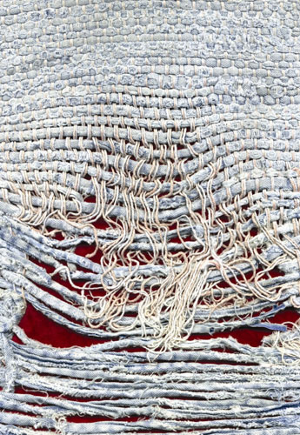
Notes:
Too few threads

Slide 17
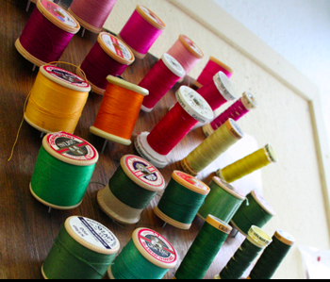
Notes:
Too many threads

Slide 18


( )
Notes:
contention

Slide 19

Notes:
One big lock

Slide 20
Notes:
Fine-grained locks (lock acquisition overhead)

Slide 21

False Sharing!
Notes:
Insidious!

Slide 22
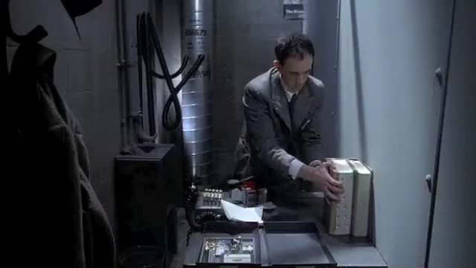
Notes:
(Brazil – didn’t know the desk was shared!)

Slide 23

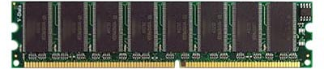
mine!
yours!
cache line
cache line
cache line
cache line
cache line

Slide 24
me = 1;
you = 1; // globals
me = new Foo;
you = new Bar; // heap
class X {
int me;
int you;
}; // fields
arr[me] = 12;
arr[you] = 13; // array indices

Slide 25
me = 1;
you = 1; // globals
me = new Foo;
you = new Bar; // heap
class X {
int me;
int you;
}; // fields
arr[me] = 12;
arr[you] = 13; // array indices

Slide 26
me = 1;
you = 1; // globals
me = new Foo;
you = new Bar; // heap
class X {
int me;
int you;
}; // fields
arr[me] = 12;
arr[you] = 13; // array indices

Slide 27
me = 1;
you = 1; // globals
me = new Foo;
you = new Bar; // heap
class X {
int me;
int you;
}; // fields
arr[me] = 12;
arr[you] = 13; // array indices

Slide 28
me = 1;
you = 1; // globals
me = new Foo;
you = new Bar; // heap
class X {
int me;
int you;
}; // fields
arr[me] = 12;
arr[you] = 13; // array indices

Slide 29

+ 850 lines…

Slide 30
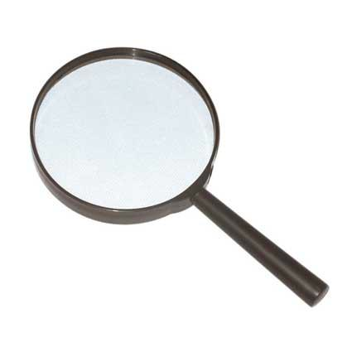
No false positives
Sheriff-Detect
Object has 13767 interleaving writes
(starts at 0xd5c8e160, length 32).
Allocation call stack:
0: wordcount.c: 136
1: wordcount.c: 444
Precise object identification

Slide 31


Slide 32
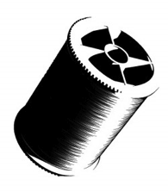
t1 = spawn f(x);
t2 = spawn g(y);
sync;

Slide 33
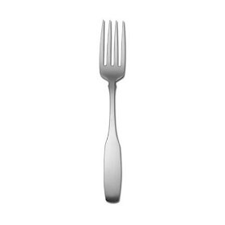
t1 = spawn f(x);
t2 = spawn g(y);
sync;
if (!fork())
f(x);
if (!fork())
g(y);

Slide 34
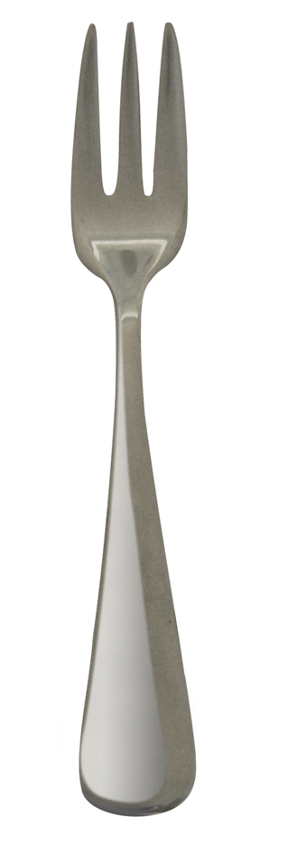
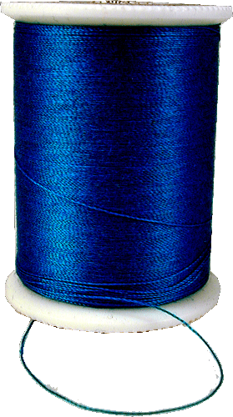
Isolation
shared address space
disjoint address spaces
Notes:
Obviously this doesn’t preserve shared memory semantics, so we need to commit changes made by one thread so they become visible to others.

Slide 35
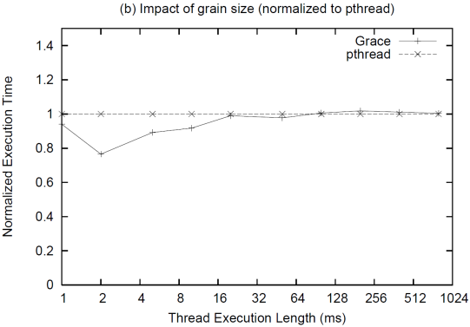
Performance: Processes vs. Threads
1.4
1.2
1.0
0.8
0.6
0.4
0.2
0.0
threads
processes
Normalized Execution Time
1 2 4 8 16 32 64 128 256 512 1024
Thread Execution Time (ms)
Notes:
ADD ANIMATIONS: threads initially on one core then migrating, vs. processes spewed across cores

Slide 36
Performance: Processes vs. Threads
1.4
1.2
1.0
0.8
0.6
0.4
0.2
0.0
threads
processes
Normalized Execution Time
1 2 4 8 16 32 64 128 256 512 1024
Thread Execution Time (ms)
Notes:
ADD ANIMATIONS: threads initially on one core then migrating, vs. processes spewed across cores

Slide 37
Performance: Processes vs. Threads
1.4
1.2
1.0
0.8
0.6
0.4
0.2
0.0
threads
processes
Normalized Execution Time
1 2 4 8 16 32 64 128 256 512 1024
Thread Execution Time (ms)
Notes:
ADD ANIMATIONS: threads initially on one core then migrating, vs. processes spewed across cores

Slide 38

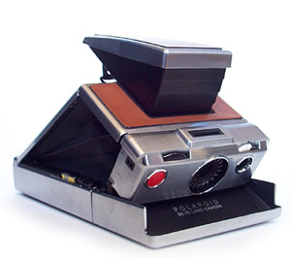

Slide 39



Slide 41
X
Y
for (i = 0; i < M; i++)
{
x = 1;
}
for (i = 0; i < M; i++)
{
y = 2;
}

Slide 42
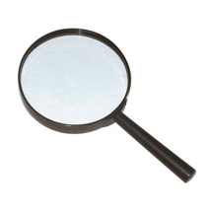
X
Y
0
0
0
0
for (i = 0; i < M; i++)
{
x = 1;
}
for (i = 0; i < M; i++)
{
y = 2;
}

Slide 43
X
Y
0
0
0
0
1
0
for (i = 0; i < M; i++)
{
x = 1;
}
for (i = 0; i < M; i++)
{
y = 2;
}

Slide 44
X
Y
0
0
0
0
1
0
0
2
for (i = 0; i < M; i++)
{
x = 1;
}
for (i = 0; i < M; i++)
{
y = 2;
}

Slide 45
X
Y
0
0
0
0
1
0
0
2

Slide 46
X
Y
0
0
0
0
1
0
0
2
1
0

Slide 47
X
Y
0
0
0
0
1
0
0
2
1
0

Slide 48
X
Y
0
0
0
0
1
0
0
2
1
2

Slide 49
X
Y
0
0
0
0
1
0
0
2
1
2

Slide 50
Output: PTU vs. Sheriff-Detect
Benchmarks | PTU (# shared lines) | SHERIFF-DETECT (# shared objects)
canneal | 1 | 1
fluidanimate | 3 | 1
kmeans | 1916 | 2
linear_regression | 5 | 1
matrix_multiply | 468 | 0
pbzip2 | 14 | 0
pca | 45 | 0
pfscan | 3 | 0
reverse_index | N/A | 0
streamcluster | 9 | 1
word_count | 4 | 4
swaptions | 196 | 0
TOTAL | 2,664 | 15
kmeans 1916 2
reverse_index N/A 5
Total 2,664 15
Notes:
Joke: I haven’t verified every reports of PTU. Because the output of PTU is non actionable and there are many false positives, I will have to spend a lot of time to figure out one problem.
If I have to figure out all of these problems, I won’t graduate for ever.
Allocation sites/cache lines, we intercept memory allocation/free operations.
Example: one allocation site, called 100 times. PTU can at least report 100 cache lines, but sheriff-detect only report once since they are from the same allocation sites.
They can’t distinguish false sharing and true sharing.
They can overstate the occurs of false sharing problem since they don’t take interleaved memory access into account.
PTU can’t differentiate true sharing and false sharing,
They can’t tell when heap object is re-used.
They will report some cases when memory access are not interleaved.
In total,

Slide 53
char padding[64];

Slide 54
Sheriff-Detect overhead
Sheriff-Detect

Slide 55


Slide 56

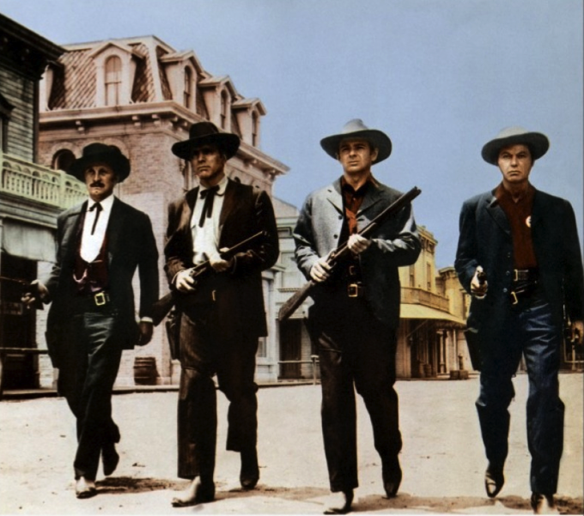
Prevents all false sharing
Sheriff-Protect

Slide 57

X
Y
0
0
0
0
1
0
0
2
for (i = 0; i < M; i++)
{
x = 1;
}
for (i = 0; i < M; i++)
{
y = 2;
}

Slide 58
Sheriff-Detect overhead
Sheriff-Detect
Sheriff-Patrol overhead
Sheriff-Protect

Slide 59
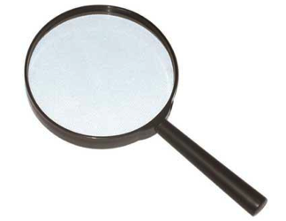
false sharing detection
original program
Sheriff-Detect
Sheriff-Detect

Slide 60

false sharing detection
Use Sheriff-Detect reports to guide modifications (padding, alignment)
original program
modified program
Sheriff-Detect
libpthread
False Sharing!
Sheriff-Detect

Slide 61
false sharing detection
Use Sheriff-Detect reports to guide modifications (padding, alignment)
original program
modified program
Sheriff-Detect
libpthread
False Sharing!
Sheriff-Detect
no false sharing
original program
libpthread

Slide 62

false sharing detection
Use Sheriff-Detect reports to guide modifications (padding, alignment)
original program
modified program
Sheriff-Detect
libpthread
False Sharing!
Sheriff-Detect
source code unavailable or insufficient resources to act on Sheriff-Detect reports
no false sharing
modifications degrade performance or cause excess memory consumption
original program
original program
libpthread
Sheriff-Protect
false sharing mitigation
Sheriff-Protect

Slide 63
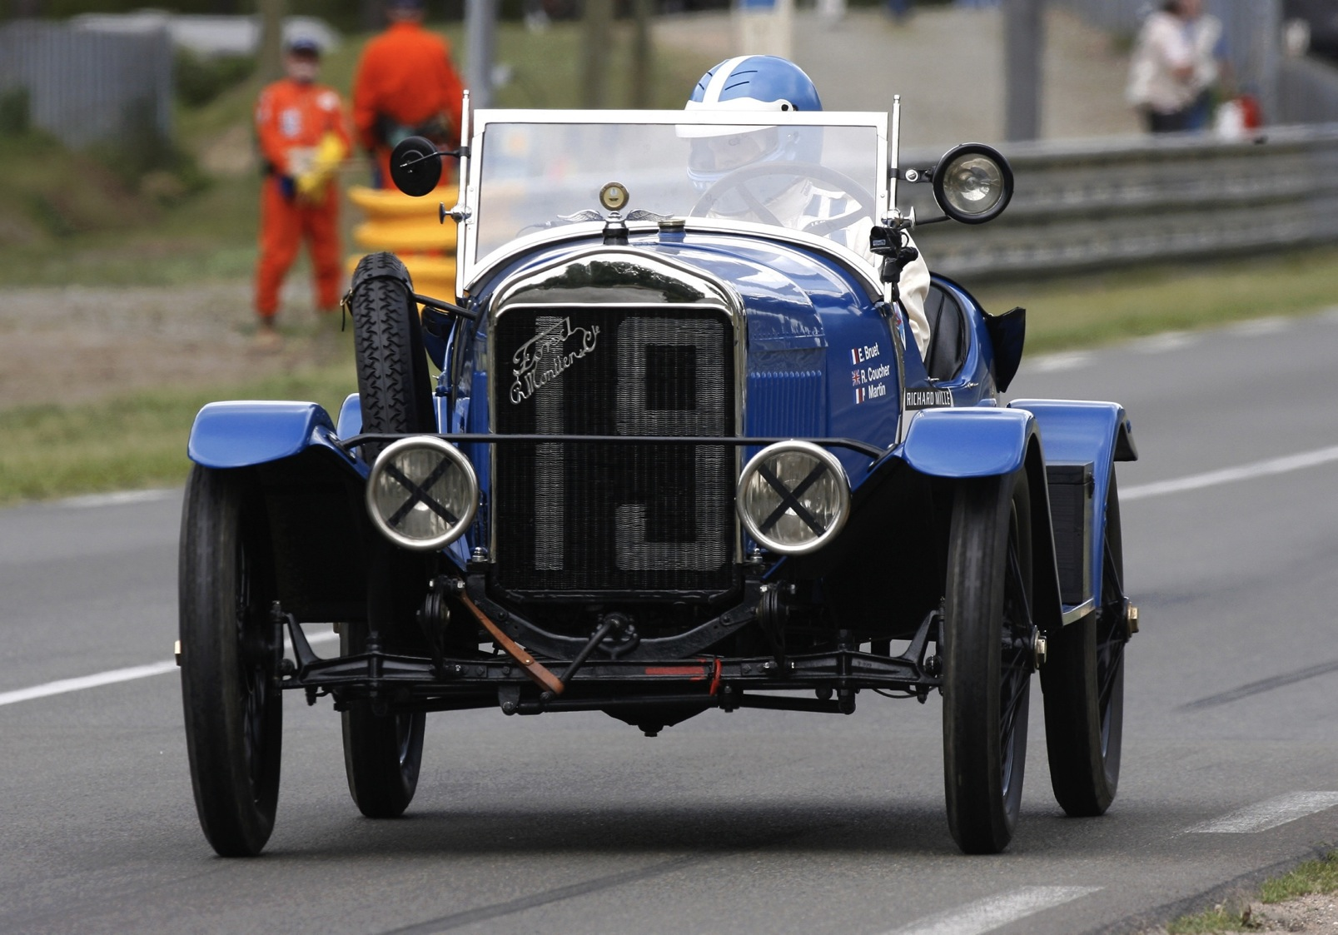

Slide 64
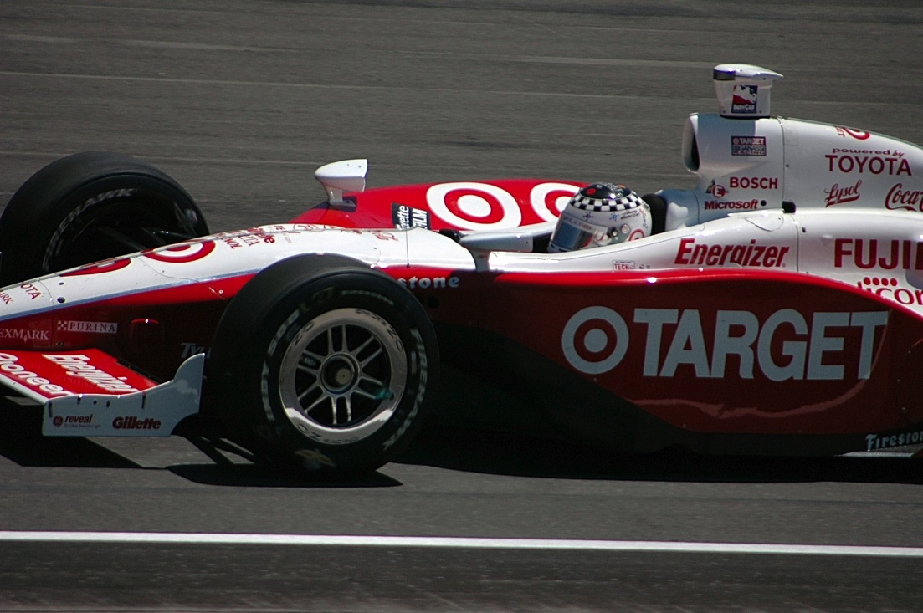

Slide 65
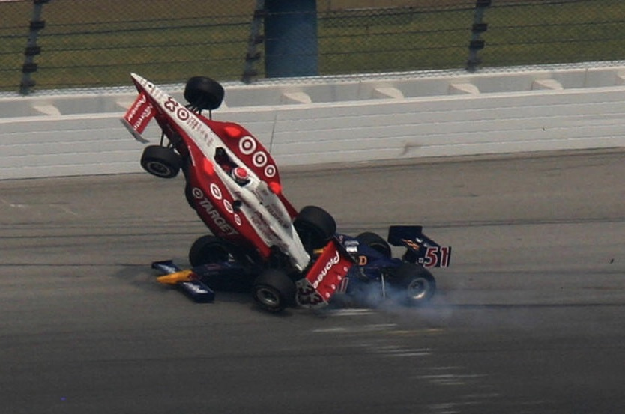

Slide 66
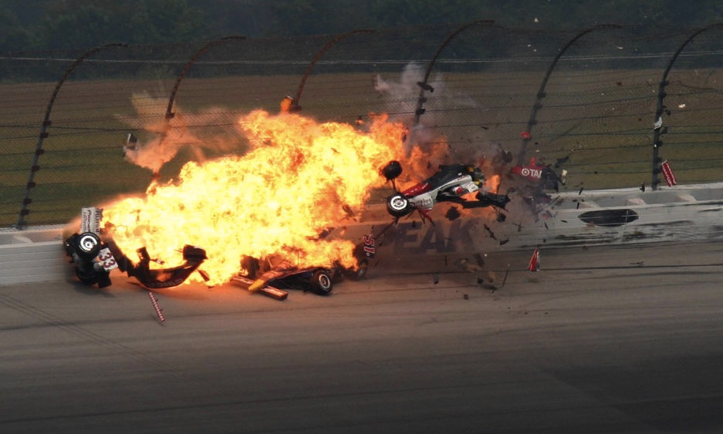

Slide 70
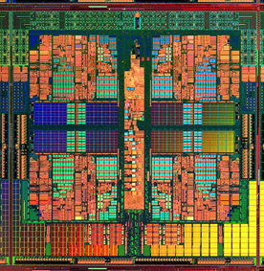
Dthreads
% g++ myprog.cpp –ldthreads –o myprog

Slide 71
race conditions
Dthreads
atomicity violations
deadlock
order violations

Slide 72

race conditions
Dthreads
atomicity violations
deadlock
order violations
deterministic

Slide 76
Dthreads: Easy to Use
% g++ myprog.cpp –l thread
p

Slide 77

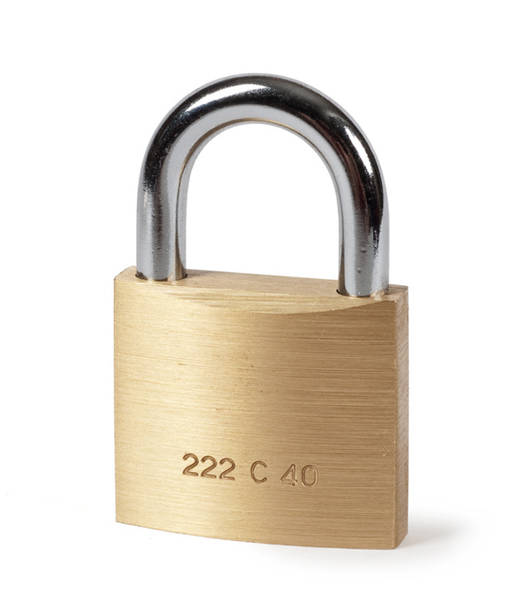
Update in Deterministic Time & Order
Parallel
Serial
Parallel
mutex_lock
“Thread” 1
cond_wait
“Thread” 2
pthread_create
“Thread” 3

Slide 78
a b
a b
0 0
0 0

Slide 79
a b
a b
0 0
0 0
1 0
0 1

Slide 80
a b
a b
0 0
0 0
1 0
0 1
1 1

Slide 82
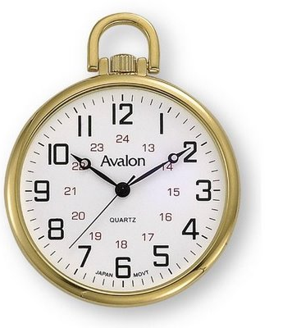
Dthreads performance analysis
Notes:
It’s not *always* as fast or faster than pthreads. Slow THEN HIGHLIGHT THE FASTER PARTS.

Slide 83
Sheriff-Detect
Sheriff-Protect

Slide 84
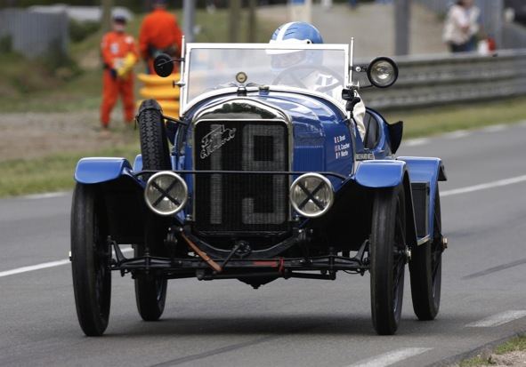
Sheriff-Detect
Sheriff-Patrol

Slide 85
Sheriff-Detect
Sheriff-Protect
Dthreads

Slide 86
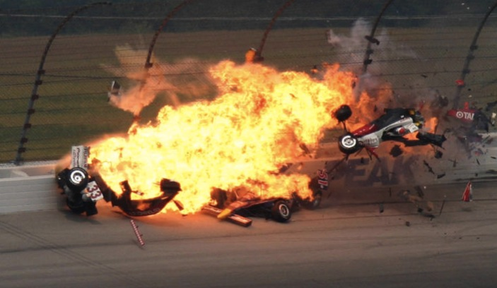
Sheriff-Detect
Sheriff-Protect
Dthreads
[OOPSLA 2011]
[SOSP 2011]

Slide 87

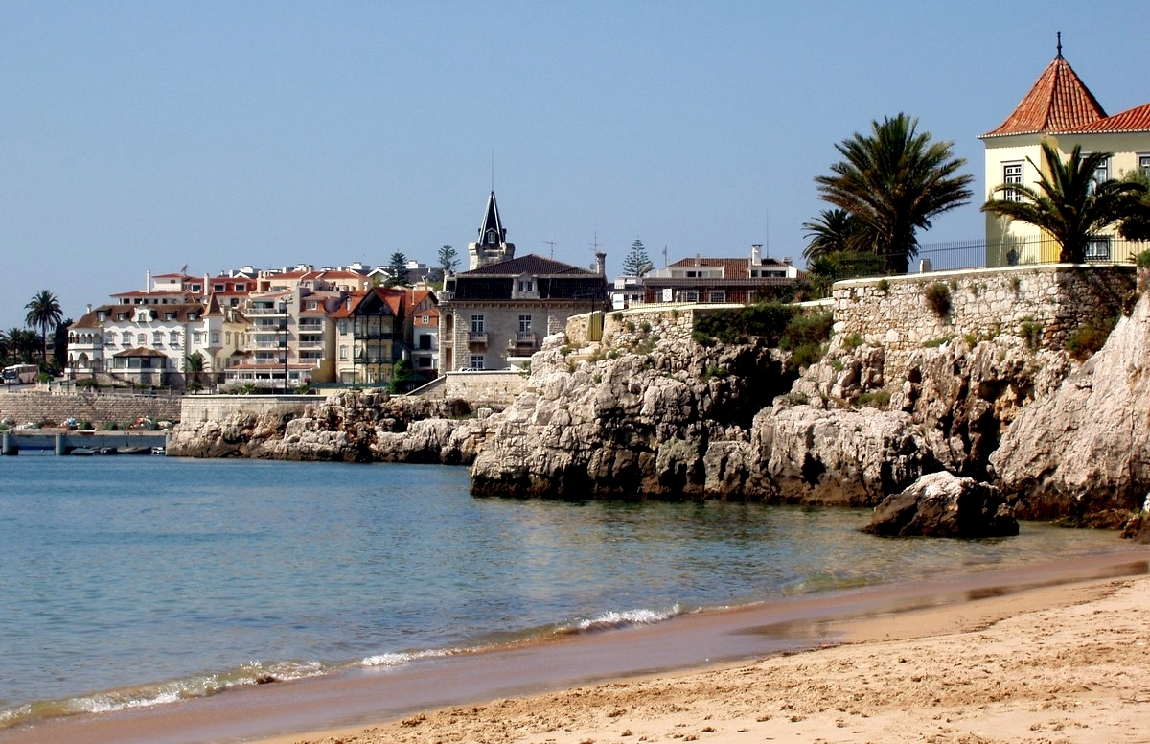
[OOPSLA 2011]
[SOSP 2011]

Slide 88
[OOPSLA 2011]
[SOSP 2011]

Slide 89
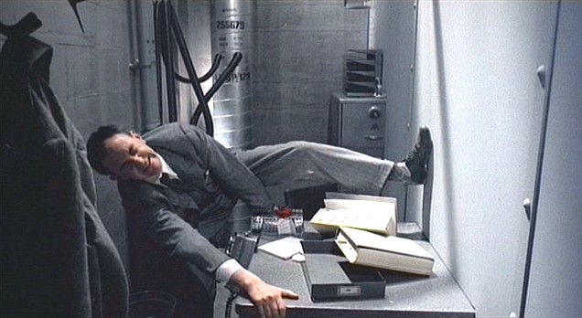
Notes:
(Brazil – didn’t know the desk was shared!)

Slide 90
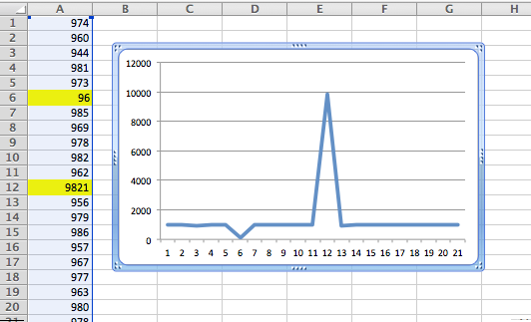
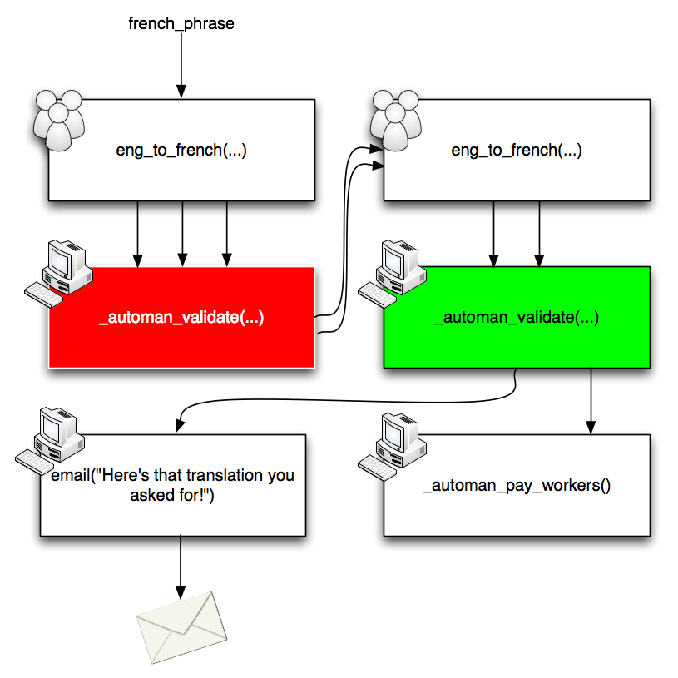



Stabilizer: Sound Performance Analysis
Data Debugging
AutoMan: Programming the Crowd
LockDown: Securing Software

